Slide 1

INTRODUCTION TO DBMS

Slide 2
A DBMS contains information about a particular enterprise and presents an environment for convenient and efficient use of that data such as performing different operations like access, updating, addition and deletion of data. DBMS is the database itself along with all the software and functionality.

Slide 3
Why dbms?
File system v/s dbms

Slide 4
File system has major disadvantages-
Data redundancy and inconsistency
Difficulty in accessing data
Data isolation
Integrity problems
Atomicity problems
Concurrent –access anomalies
Security problems

Slide 5
Databases are of two types – Relational Database(or the SQL database) and NoSQL
SQL stands for structured query language.

Slide 6
Relational database
Data is stored in the form of tables and every row is like a data entry or a record. The columns are the attributes.
A sample relational database.

Slide 7
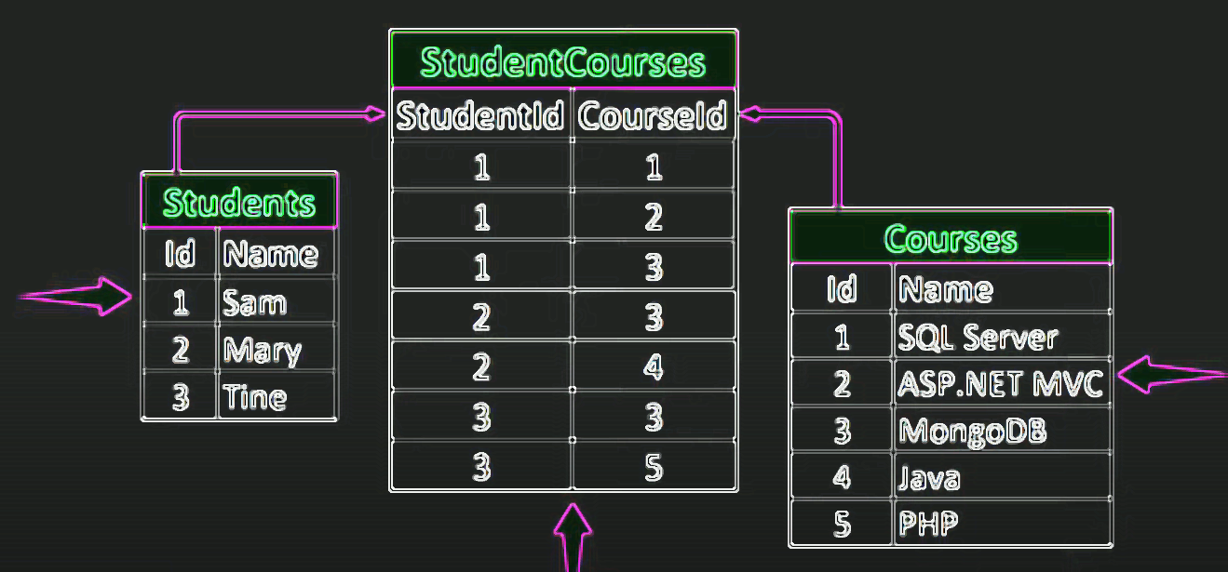
ID | name | Dept_name | salary
22222 | Einstein | Physics
12121 | Wu | Finance
32343 | El Said | History
45565 | Katz | Comp. sci.
98345 | Kim | Elec. Eng.
76766 | Crick | Biology
10101 | Srinivasan | Comp. Sci.
58583 | Califieri | History
83821 | Brandt | Comp. sci.
15151 | Mozart
33456 | Gold
76543 | Singh

Slide 8
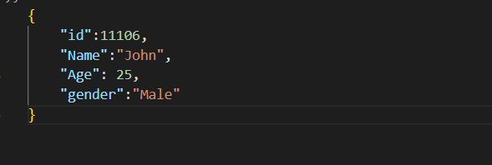
NoSQL
Data is stored in the form of collections and a collection contains documents.

Slide 9
Relational database | NoSQL
Database | Database
Table | Collection
Row | Document
Column | Field

Slide 10
Relational database V/S NoSQL

Slide 11
RELATIONAL DATABASE | NoSQL
It is used to handle data coming in low velocity and handles data in less volume. | It is used to handle data coming in high velocity and handles data in high volume.
Normalization prevents duplication of data and limits redundancy and anomalies. | Same data is stored at multiple places.
Comparatively easier to access data. | Comparatively lesser ease of access.
Deployed in vertical fashion. | Deployed in Horizontal fashion.
Data arrives from one or few locations. | Data arrives from many locations.
It has single point of failure. | No single point of failure.

Slide 12
KEYS
K is a set of one or more attributes(non-empty).
K is a Superkey if it can uniquely identify each and every row of the table. For ex. {ID}, {ID, name} can act as a superkey for instructors.
Now, we say a super key K is a candidate key, if K is minimal
There could be multiple candidate key in a relation, if there are multiple candidates key then we select one to be the primary key.

Slide 13
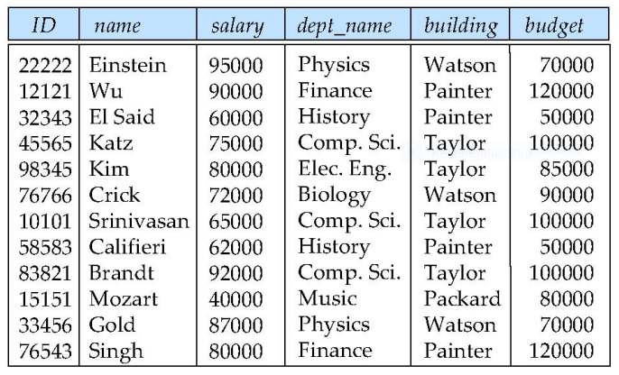
INSTRUCTORS

Slide 14
Super Key: Roll #, {Roll #, DoB}
Candidate Keys: Roll #, {First Name, Last Name}, Aadhaar #
Passport # cannot be a key. Null values are allowed for Passport #
Primary Key: Roll #
Secondary / Alternate Key: {First Name, Last Name}, Aadhaar #
Simple key: Consists of a single attribute
Composite Key: {First Name, Last Name}
Consists of more than one attribute to uniquely identify an entity occurrence
Roll# | First Name | Last Name | DoB | Passport # | Aadhaar # | Department
15CS10026 | Lalit | Dubey | 27-Mar-1997 | L4032464 | 1728-6174-9239 | Computer
16EE30029 | Jatin | Chopra | 17-Nov-1996 | null | 3917-1836-3816 | Electrical
15EC10016 | Smriti | Mongra | 23-Dec-1996 | G5432849 | 2045-9271-0914 | Electronics
16CE10038 | Dipti | Dutta | 02-Feb-1997 | null | 5719-1948-2918 | Civil
15CS30021 | Ramdin | Minz | 10-Jan-1997 | X8811623 | 4928-4927-5924 | Computer

Slide 15
FOREIGN KEY
The key having roll number the; roll number itself is a key of another relation and the course number itself is a key of another relation. So, when we take the keys of other relations to form the key of a relation then we say that these are foreign keys. So, roll number and course number are foreign keys in student and course and since from enrolment the student and courses are being referenced are being referred.
STUDENTS
Roll# | First Name | Last Name | DoB | Passport # | Aadhaar # | Department
COURSES
Course # | Course Name | Credits | L-T-P | Department
ENROLMENT
Roll # | Course # | Instructor ID

Slide 16
ER MODEL (Entity Relationship Model)
Entity Set
Relationship Set
Attributes

Slide 17
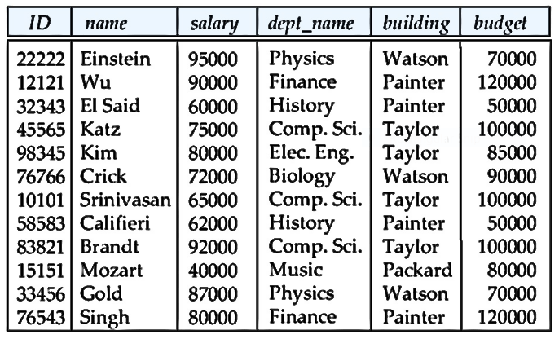
INSTRUCTORS

Slide 18
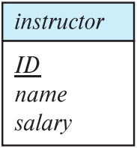
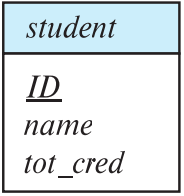
This is how we can represent entity sets in an ER Diagram
Rectangles represent entity sets.
Attributes are listed inside the rectangle.
Primary key is underlined.

Slide 19
The entity set can also be represented as
ID
Name
tot_cred
Student

Slide 20
Types of Relationships
Any association between two entity sets is called a relationship. Types of relationships –
One-to-One Relationship
One-to-Many or Many-to-One Relationship
Many-to-Many Relationship

Slide 21
A relationship set defines the relationship between entity sets.
It is represented by a diamond shape in ER diagram.

Slide 22
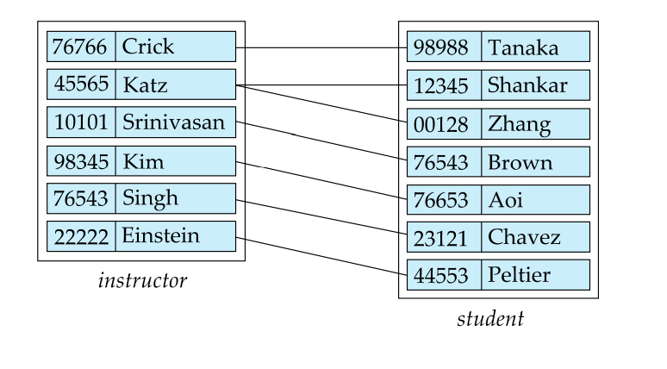
advisor

Slide 23
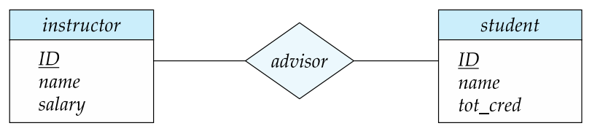
ER Diagram Representation
The relationship set might also contain attributes.

Slide 24
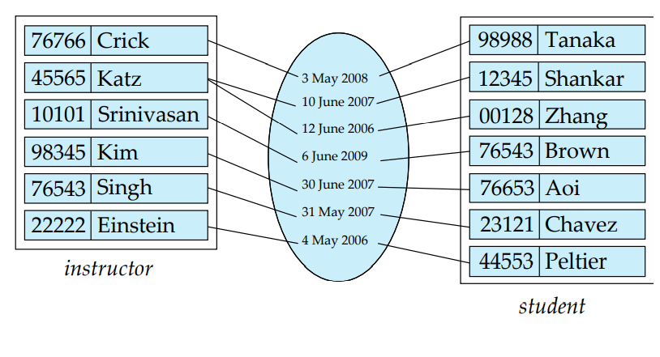

Slide 25
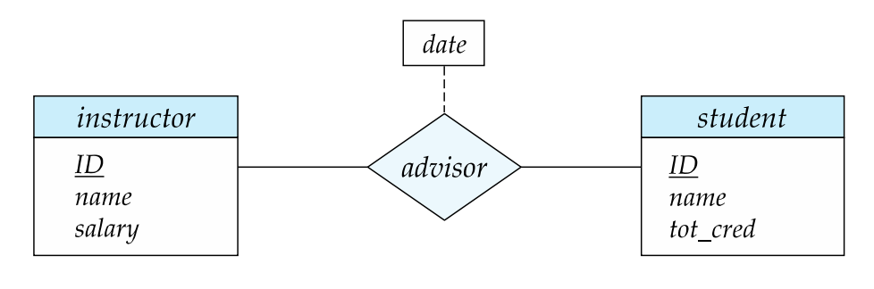
This can be represented by

Slide 26
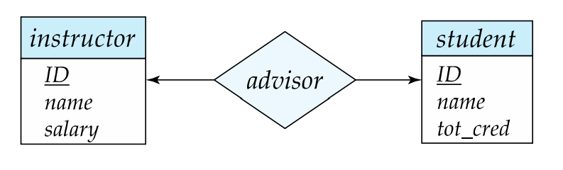
One to One relationship

Slide 27
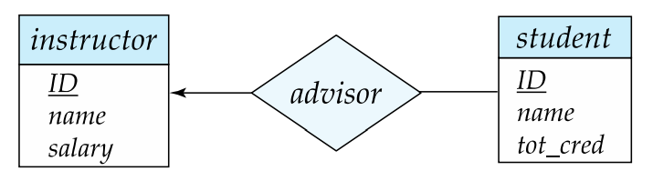
One to Many relationship

Slide 28
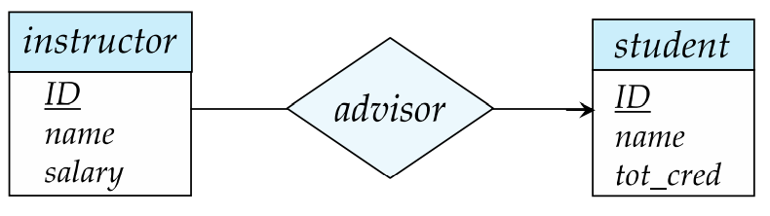
Many to one relationship

Slide 29
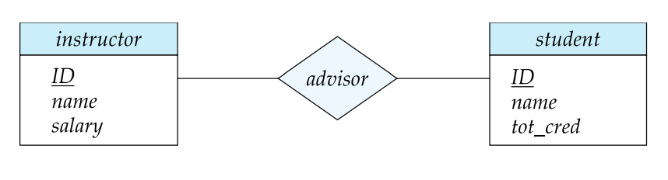
Many to Many Relationship

Slide 30
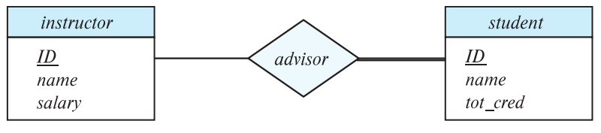
Total and Partial Participation
Total participation represented by double line.

Slide 31
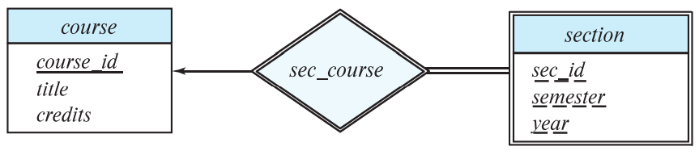
Weak entity Set
A weak entity set doesn't have a superkey and is dependent on some other set(strong entity set) through a relationship set so that each and every row in that weak entity set can be uniquely identified.

Slide 32
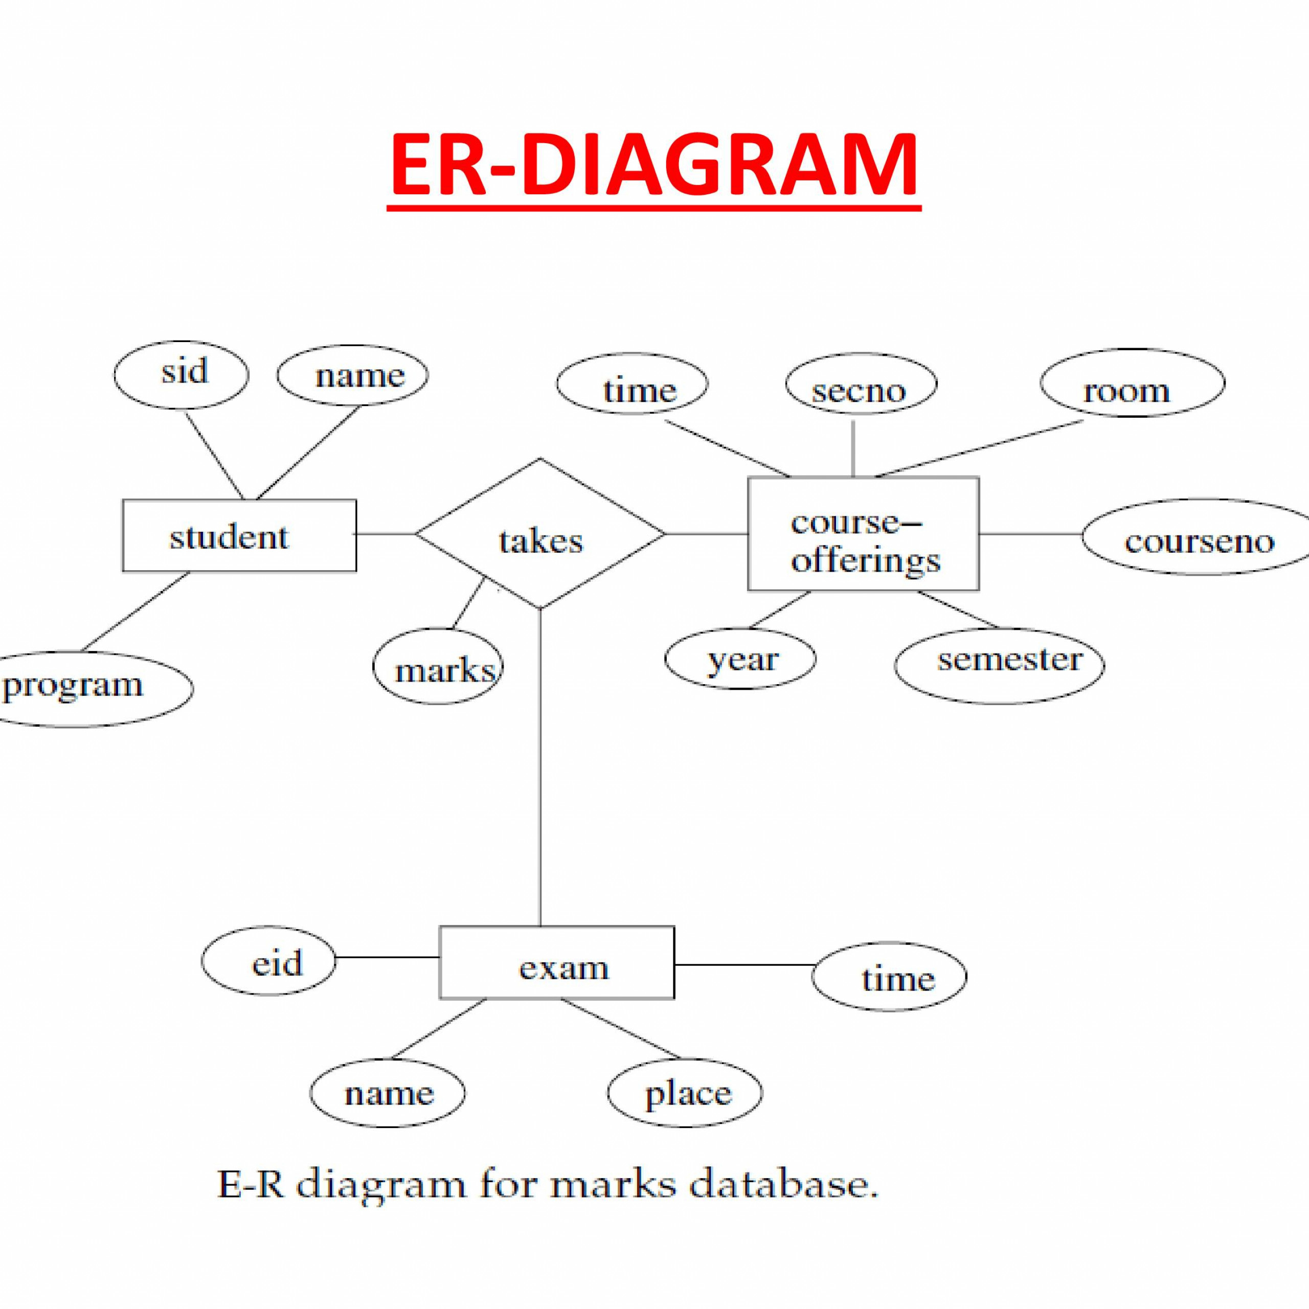

Slide 33
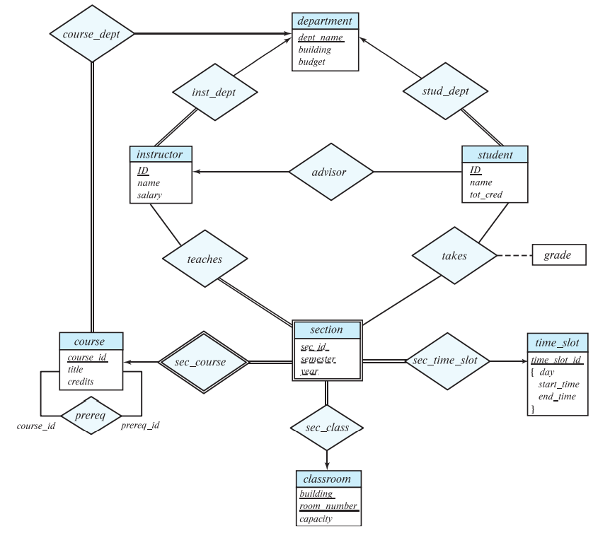

Slide 34
NORMALIZATION
Normalization is the process of minimizing redundancy from a relation or set of relations. Redundancy in relation may cause insertion, deletion, and update anomalies. So, it helps to minimize the redundancy in relations. Normal forms are used to eliminate or reduce redundancy in database tables.

Slide 35
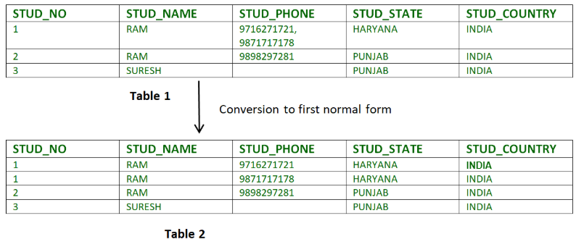
FIRST NORMAL FORM
A relation is in first normal form if every attribute in that relation is singled valued attribute.

Slide 36
SECOND NORMAL FORM
To be in second normal form, none of the non-key attributes must be dependent on a proper subset of the candidate key.

Slide 37
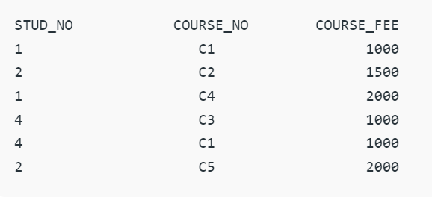
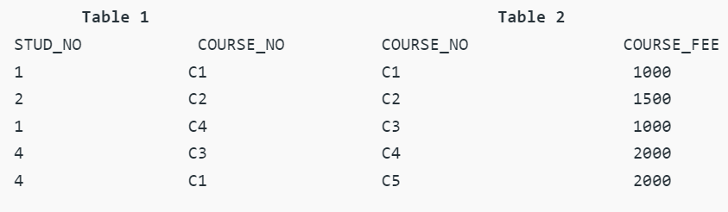

Slide 38
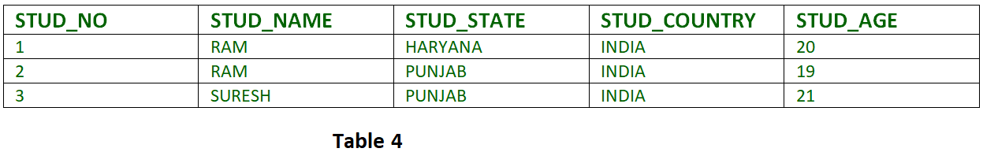
THIRD NORMAL FORM
A relation is in third normal form, if there is no transitive dependency for non-prime attributes as well as it is in second normal form. Transitive dependency – If A->B and B->C are two FDs then A->C is called transitive dependency.

Slide 39
SQL

Slide 40

ThaNk You

